Slide 1

TRUTH FORCE
The Guardians
Ankur Kishorbhai Rokad (C0793757)
Avinash Ravi (C0791941)
Sahista Patel (C0796681)
Vishal Sabarinath Venkatesan (C0801202)
Truth Force

Slide 2
INTRODUCTION
Technological advancements have drastically increased the amount of internet and social media users.
An average user receives information from platforms like Facebook, Twitter, Reddit and Instagram.
There is a high chance that the information is bogus and is specifically crafted to spread wrong information.
Goal : To classify the Fake information using ML.
Truth Force

Slide 3
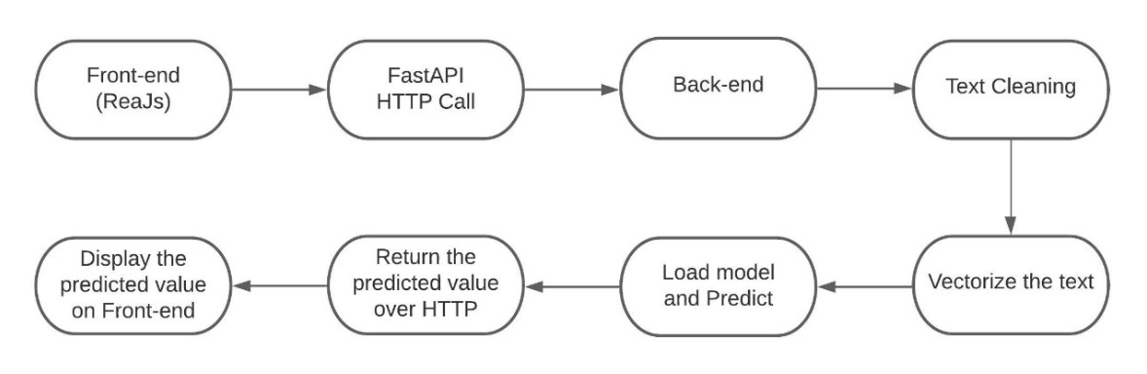
PROJECT OVERVIEW
Truth Force

Slide 4
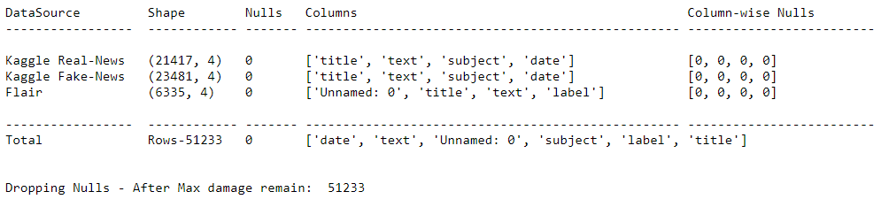
DATA SET
We collected our data from Kaggle and Data flair.
Dataset contains over 50k records.
Out target variable is label which is categorized into FAKE and REAL.
Truth Force
Truth Force

Slide 5
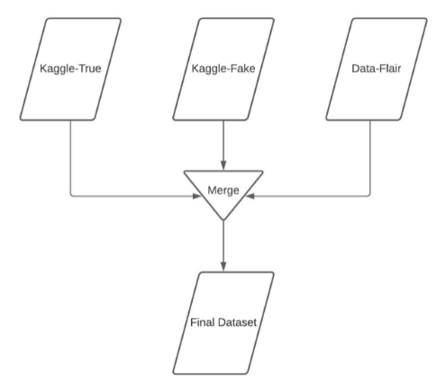
DATA PREPARATION
Merged the Datasets
Handled Missing values
Removed Duplicates
Checked for Data set Uniformity
Truth Force

Slide 6
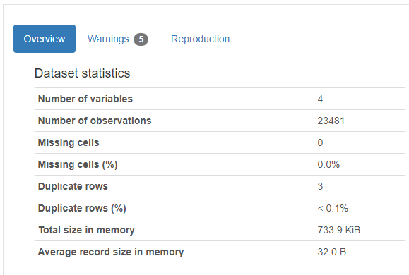
PROFILING REPORT
Provides visualizing and understanding the distribution of each variable
Provides information on:
missing vales
Duplicates
Sample and Overview of the Data Frame.
Pandas Profiling
Truth Force

Slide 7
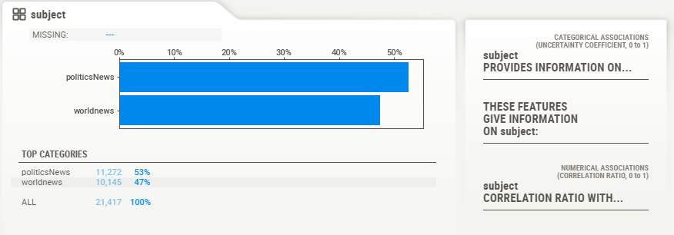
PROFILING REPORT
Sweet viz profiling report to identify trends and patterns in our dataset.
Sweet viz Profiling
Truth Force

Slide 8
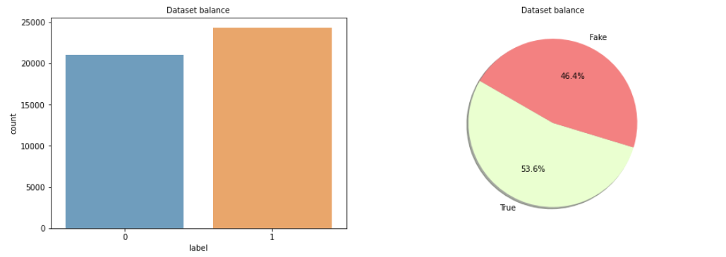
EXPLORATORY DATA ANALYSIS
Data Set Distribution
Truth Force

Slide 9
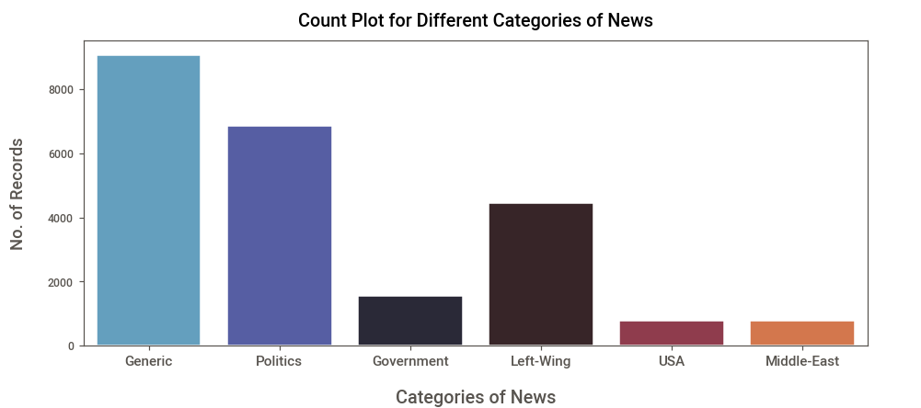
EXPLORATORY DATA ANALYSIS

Slide 10
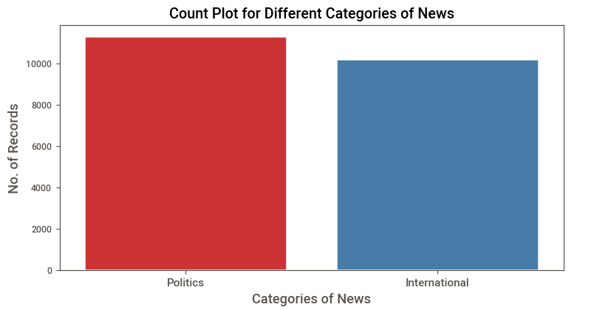
EXPLORATORY DATA ANALYSIS
Truth Force

Slide 11
TEXT PROCESSING
Stemming and Lemmatizing all the comments
Cleaning the comments by removing:
URLs
Contractions
Stop-words
HTML tags
Symbols
Punctuation
Special Characters
Truth Force

Slide 12
DATA MODELING
We have used six models for training our data set.
They are:
SVM
Passive Aggressive Classifier
Random Forest
XG Boost Classifier
Naïve Bayes Classifier
LSTM
Truth Force

Slide 13
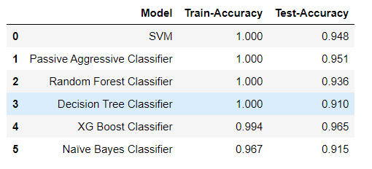
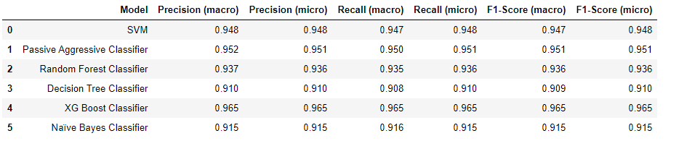
PERFORMANCE MEASURE
Truth Force

Slide 14
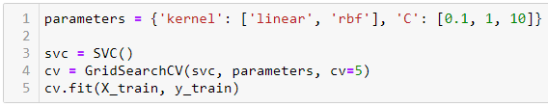

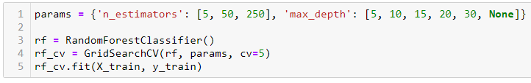
CROSS VALIDATION
svc
Random Forest
Truth Force

Slide 15
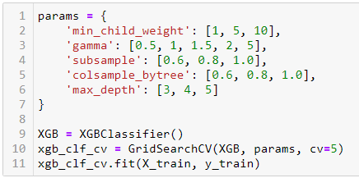
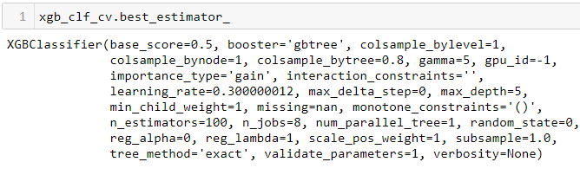
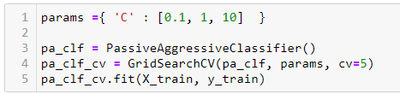

CROSS VALIDATION
Passive Aggressive Classifier
XGB
Truth Force

Slide 16
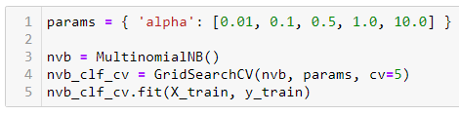

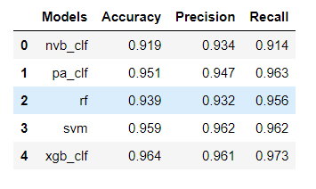
CROSS VALIDATION
Naïve Bayes
Validation
Truth Force

Slide 17
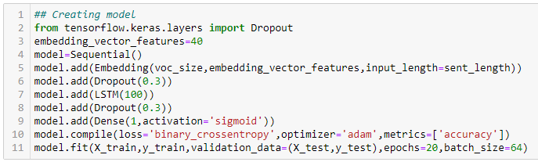

PERFORMANCE MEASURE
LSTM
Truth Force
17

Slide 18
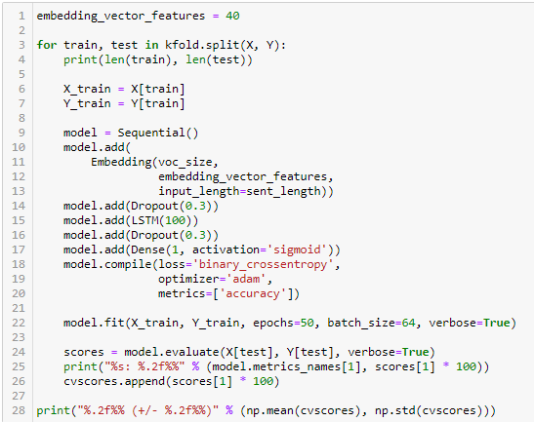
PERFORMANCE MEASURE
LSTM Cross Validation
Truth Force
18

Slide 19
FRONT END - ReactJS
ReactJS simplifies the overall process of scripting components.
It facilitates advanced maintenance and boosts productivity.
It is a component-based architecture allows quicker rendering and easy state management.
Truth Force

Slide 20
MIDDLEWARE - FastAPI
One of the fastest frameworks compared to Flask and Django.
Development time is less.
It is easy to test and deploy.
Seamless central exception handling.
It supports asynchronous code.
Truth Force

Slide 21
BACKEND – ML Model
ML model
Text processing
Text vectorization
Loading and prediction
Truth Force

Slide 22
CONCLUSION
As RNN’s are known to work well with Text Data and Time series problems statements, we preferred LSTM over XG Boost for classification.
We can further improve the model's performance by training it over a larger datasets and Hyperparameter Tuning.
Our project can help to tackle:
In predicting if given information is genuine or fake
Media house challenges
Information assurance
Mitigate hoax
Attenuate pseudoscientific statements
Truth Force

Slide 23
Questions?
Truth Force

Slide 24
Thank you
Ankur Rokad
Avinash Ravi
Sahista Patel Vishal Sabarinath
Truth Force

